Slide 1


STARTUP ECOSYSTEM ANALYSIS
PRESENTED BY: SEJAL CHAWLA

Slide 2


🎯 AIM OF THE ANALYSIS
THE AIM OF THIS ANALYSIS IS TO STUDY THE SUCCESS FACTORS OF STARTUPS BY EXAMINING FUNDING, VALUATION, REVENUE, PROFITABILITY, INDUSTRY TRENDS, AND EXIT OUTCOMES.
“THE GOAL IS TO IDENTIFY WHAT DRIVES A STARTUP TOWARDS SUCCESS OR FAILURE."

Slide 3
DATASET INTRODUCTION
📌 SOURCE
The dataset was collected from Kaggle, a popular open data and machine learning platform.
📌 DATA FIELDS (COLUMNS)
Startup Name – identifier of each startup
Industry – category/domain (e.g., AI, E-commerce, Fintech)
Funding Amount (USD) – total raised by the startup
Valuation (USD) – estimated company worth
Revenue (USD) – reported revenue figures
Profitable (Yes/No or 1/0) – profitability status
Employees – number of employees
Market Share (%) – competitive standing in market
Year Founded – founding year of the startup
Region/City – location of headquarters
Exit Status – IPO, Acquired, or Still Private
📌 TYPE OF DATA
STRUCTURED DATASET IN CSV FORMAT.
CONTAINS TABULAR RECORDS OF STARTUPS, WITH BOTH NUMERICAL AND CATEGORICAL VARIABLES.

Slide 4

INTRODUCTION
STARTUP REFERS TO A BUSINESS THAT IS JUST GETTING STARTED.
Startups are created by one or more entrepreneurs who desire to provide a good or service they feel there is a market for.
Startups are innovative ventures initiated by entrepreneurs for specific market needs or to resolve the problems that prevail in the market by launching unique products, services or business models.

Slide 5

💡 WHY CHOOSE THIS FIELD (STARTUPS)?
1
STARTUPS ARE THE BACKBONE OF ECONOMIC GROWTH, JOB CREATION, AND INNOVATION.
THE FAILURE RATE IS VERY HIGH (AROUND 90%), MAKING IT IMPORTANT TO UNDERSTAND WHY SOME SUCCEED.
POLICYMAKERS, INVESTORS, AND ENTREPRENEURS ALL RELY ON SUCH INSIGHTS.
THE DATASET COVERS MULTIPLE ASPECTS (FUNDING, REVENUE, EMPLOYEES, REGION, INDUSTRY), SO IT GIVES A HOLISTIC VIEW.
THIS ANALYSIS WILL HELP IN IDENTIFYING PATTERNS AND STRATEGIES THAT INCREASE THE PROBABILITY OF SUCCESS.
3
4

Slide 6
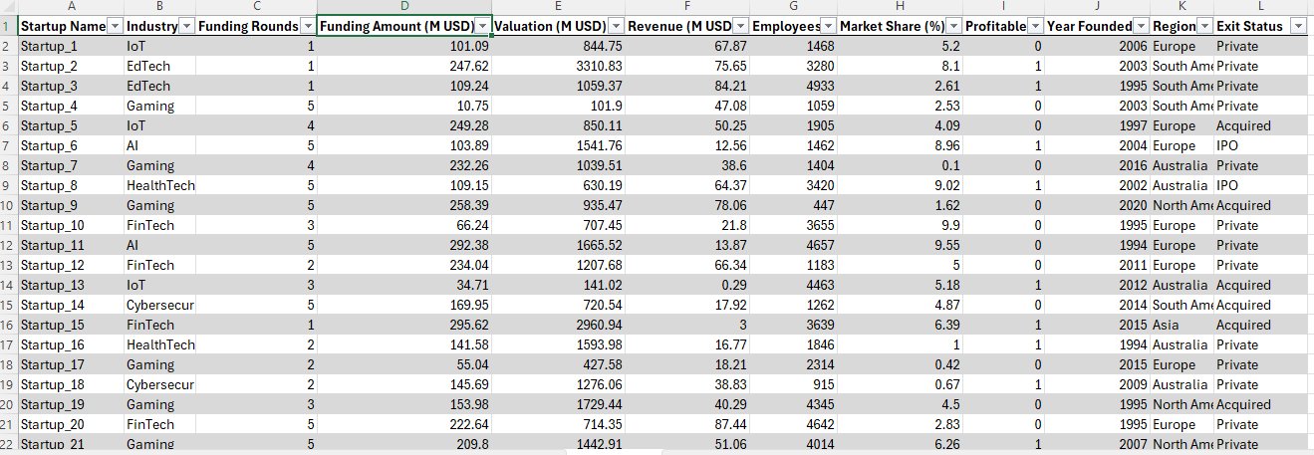
DATA PREPROCESSING AND TRANSFORMATION FOR ANALYSIS

Slide 7

EXPLORATORY DATA ANALYSIS

Slide 8
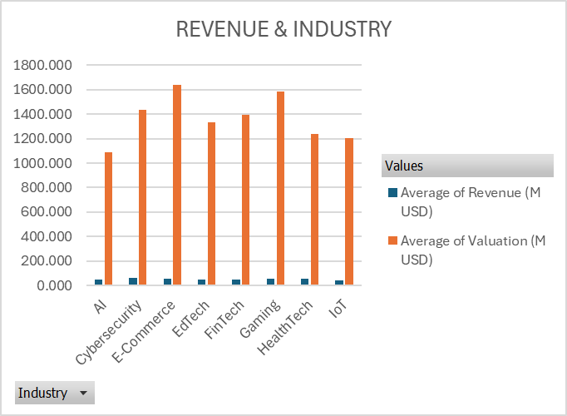
REVENUE AND INDUSTRY INSIGHTS
AVERAGE REVENUE AND VALUATION BY INDUSTRY
INSIGHTS:
VALUATION IS MUCH HIGHER THAN REVENUE ACROSS INDUSTRIES
TOP VALUATION INDUSTRIES
E-COMMERCE (1640M), GAMING (1585M), CYBERSECURITY (1437M) HAVE THE HIGHEST VALUATIONS.
RECOMMENDATIONS :
“INVESTORS SHOULD BALANCE HIGH-GROWTH BETS (E-COMMERCE, GAMING) WITH REVENUE-STRONG BUT UNDERVALUED SECTORS LIKE CYBERSECURITY.”

Slide 9
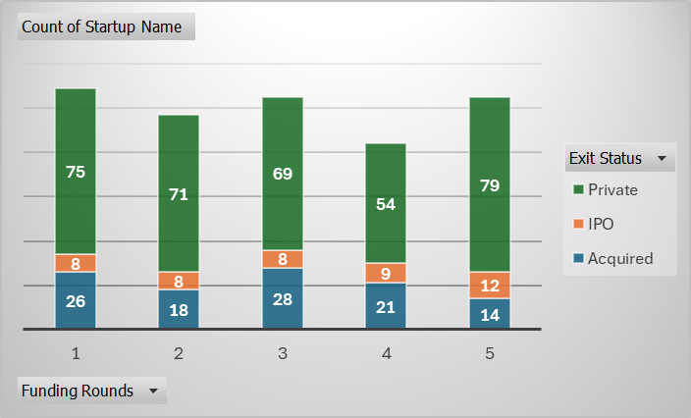
FUNDING VS OUTCOME
INSIGHT: SHOWS IF MORE FUNDING ROUNDS INCREASE CHANCES OF IPO OR ACQUISITION.
THE TOTAL NUMBER OF STARTUPS IN THE DATASET IS 500. THE BAR CHART SHOWS A CONSISTENT COUNT OF STARTUPS FOR EACH FUNDING ROUND CATEGORY, WITH TOTALS RANGING FROM 84 TO 109.
STARTUPS WITH FEWER FUNDING ROUNDS TEND TO HAVE A HIGHER COUNT OF ACQUISITIONS. THE NUMBER OF ACQUISITIONS IS HIGHEST FOR STARTUPS WITH 1 FUNDING ROUND (26), FOLLOWED BY THOSE WITH 3 ROUNDS (28). THE TREND GENERALLY SHOWS A HIGHER NUMBER OF ACQUISITIONS IN THE EARLIER STAGES OF FUNDING. THIS COULD SUGGEST THAT COMPANIES ARE BEING ACQUIRED FOR THEIR INITIAL TECHNOLOGY OR TEAM, RATHER THAN AFTER EXTENSIVE FUNDING AND GROWTH.

Slide 10
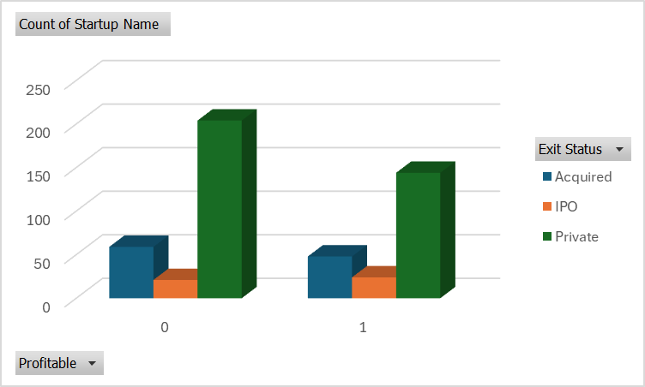
HOW PROFITABILITY LINKS TO IPOS OR ACQUISITIONS.
INSIGHTS
OVERALL DISTRIBUTION
OUT OF 500 STARTUPS, THE MAJORITY ARE STILL PRIVATE (348 = 70%).
107 WERE ACQUIRED (21%), WHILE 45 WENT IPO (9%).
ROW 0 (UNPROFITABLE/NOT YET PROFITABLE):
INDICATES THAT MOST UNPROFITABLE STARTUPS EITHER STAY PRIVATE (TO RAISE MORE FUNDING) OR GET ACQUIRED AT LOWER VALUATIONS.
ROW 1 (PROFITABLE):
IPO COUNT IS HIGHER (24) COMPARED TO UNPROFITABLE ONES (21), DESPITE FEWER PROFITABLE STARTUPS OVERALL.
SUGGESTS PROFITABILITY STRONGLY CORRELATES WITH IPO READINESS

Slide 11
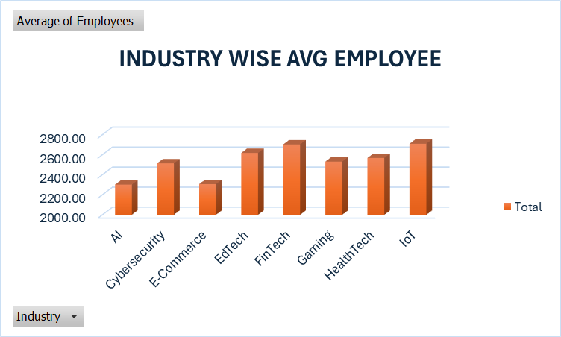
INDUSTRY WISE AVERAGE EMPLOYEE COUNT
INSIGHT: WHICH INDUSTRIES/REGIONS TEND TO HAVE LARGER TEAMS.
IOT (2709 EMPLOYEES), FINTECH (2703 EMPLOYEES), AND EDTECH (2618 EMPLOYEES) HAVE THE LARGEST AVERAGE TEAMS.
THIS SUGGESTS THAT THESE INDUSTRIES ARE MORE RESOURCE-INTENSIVE AND MAY REQUIRE BROADER TEAMS TO HANDLE OPERATIONS, R&D, AND CUSTOMER ENGAGEMENT.
RECOMMENDATION:
PROVIDE SKILL DEVELOPMENT INITIATIVES IN IOT AND FINTECH, AS THESE INDUSTRIES ARE JOB-INTENSIVE.
SUPPORT AI AND E-COMMERCE STARTUPS WITH INFRASTRUCTURE GRANTS SINCE THEY CREATE FEWER JOBS DIRECTLY BUT DRIVE HIGH INNOVATION.

Slide 12
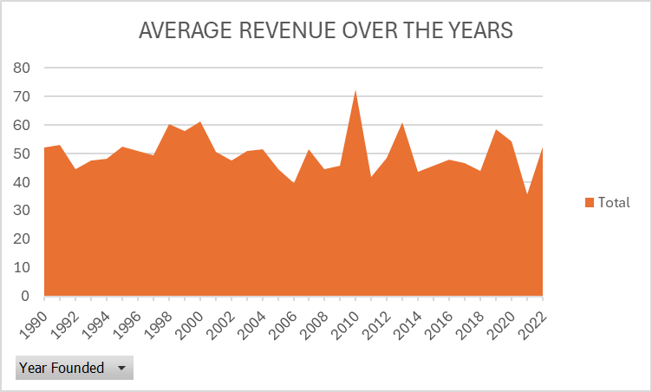
TIME TRENDS
TRENDS BY PERIODS:
1990S: MODERATE GROWTH WITH A JUMP IN 1998–2000, LIKELY DUE TO THE DOT-COM BOOM.
2001–2009: FLUCTUATIONS WITH A DIP AROUND 2005–2006 AND 2008–2009 (GLOBAL FINANCIAL CRISIS).
2010–2019: STRONG RECOVERY POST-CRISIS, WITH 2010 AND 2013 PEAKS.
2020–2022: MIXED TREND—2020 RECOVERY (54.23M) BUT SHARP FALL IN 2021, THEN PARTIAL RECOVERY IN 2022 (52.59M).

Slide 13
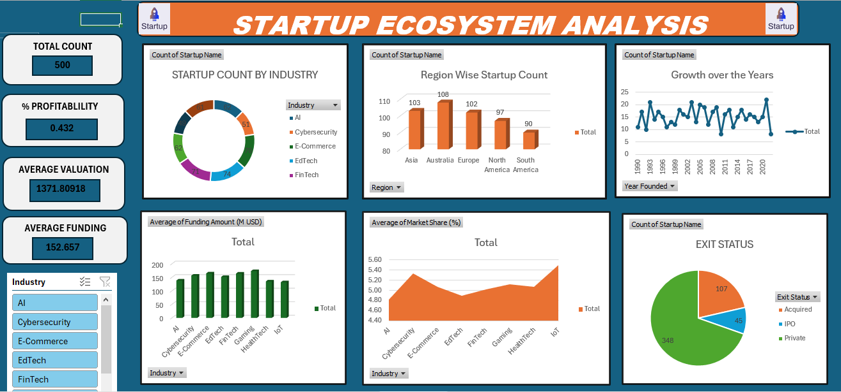
DASHBOARD

Slide 14
SUMMARY
KEY INSIGHTS FROM THE ANALYSIS:
STARTUP LANDSCAPE: THE DATASET SHOWS DIVERSE INDUSTRIES, WITH TECHNOLOGY-DRIVEN SECTORS (AI, FINTECH, E-COMMERCE) ATTRACTING THE HIGHEST FUNDING AND VALUATIONS.
PROFITABILITY VS GROWTH: ONLY A FRACTION OF STARTUPS ARE PROFITABLE, BUT THOSE THAT SUCCEED TEND TO SECURE HIGHER VALUATIONS AND LARGER MARKET SHARES.
EXIT STATUS TRENDS: MAJORITY OF STARTUPS REMAIN PRIVATE, WITH A SMALLER PROPORTION GOING PUBLIC (IPO) OR BEING ACQUIRED. ACQUISITIONS APPEAR AS A COMMON PATHWAY TO SUCCESS.
FUNDING & VALUATION: FUNDING LEVELS STRONGLY CORRELATE WITH VALUATION, BUT NOT ALWAYS WITH REVENUE, HIGHLIGHTING THE ROLE OF MARKET EXPECTATIONS OVER ACTUAL EARNINGS.

Slide 15

RECOMMENDATION
1] FOR INVESTORS
Focus on high-growth industries like AI, Fintech, and E-commerce where valuations and funding trends are strongest.
2] FOR STARTUPS/ENTREPRENEURS
PRIORITIZE ACHIEVING EARLY PROFITABILITY — DATA SHOWS PROFITABLE STARTUPS HAVE BETTER LONG-TERM SUCCESS CHANCES.
CONSIDER ACQUISITION STRATEGY AS A REALISTIC EXIT, SINCE IPOS ARE LESS FREQUENT.
BUILD IN STARTUP HUBS/REGIONS WITH STRONG ECOSYSTEMS (TALENT, INVESTORS, ACCELERATORS).
3] FOR POLICYMAKERS
SUPPORT ECOSYSTEM DEVELOPMENT IN EMERGING REGIONS TO BALANCE OPPORTUNITIES BEYOND TIER-1 CITIES.
FACILITATE ACCESS TO FUNDING FOR NON-TECH SECTORS, SINCE DATA SHOWS CAPITAL IS HEAVILY SKEWED TOWARDS TECH.

Slide 16
Thank You.

